Slide 1

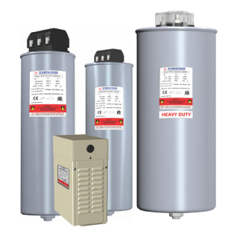
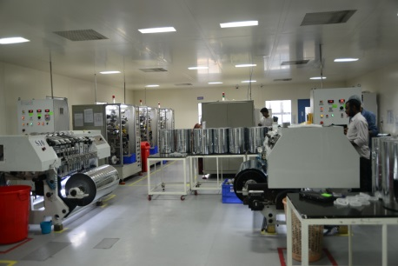
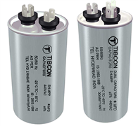
Tibrewala Electronics Ltd – An overview

Slide 2

Overview
Tibrewala Electronics Limited was started by Mr. Jyoti Prakash Tibrewala, with his rich experience in electrical fan industry, in 1985 to provide quality capacitors to fan industry, under the brand name TIBCON.
Today TIBCON capacitors has highest market share in fan & motor capacitors in India & is a leading supplier to most of the leading manufacturers in India.
TEL is a US$ 25Million Company, head quartered in Hyderabad with 4 state of the art manufacturing units & manufacture more than 40million capacitors per annum.
40% of sales are exported to 30 countries across the globe with exports of MPP film to major PFC Capacitor manufacturers in Europe and US.
A bulk of PFC capacitors are exported to South Asian Countries, Middle East, Turkey , Vietnam and many more…..
Today TEL has one of the best manufacturing facilities in the world to manufacture Capacitors, both MFD as well as PFC.

Slide 3
Infrastructure
Total Investment in plant and machinery to-date – US$ 10 Million
A new manufacturing plant has been commissioned in 2010 at Electronic Hardware Park, Shamshabad, close to the Hyderabad International Airport, with an investment of more than 3MUSD.
In house metallizing facility with 5 State of the art latest technology machines from Leybold, Germany with total 180 Tons/month Capacity
Metallized film is the basic & most critical raw material for a capacitor. We are proud to share that, we are a leading supplier for Metallized film to most of the leading Capacitor manufacturers across the globe.
Equipped with High precision Slitting Machines & fully automatic, high precision Winding Machines
Dust Free Class 10,000 Clean room for Slitting and winding
In house test lab & R&D facility.

Slide 4
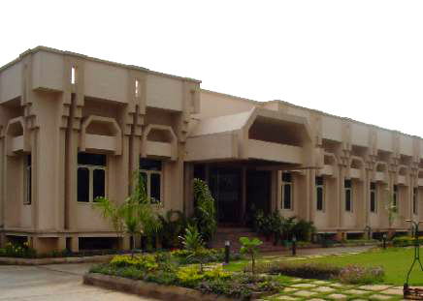
Infrastructure
Head Office & manufacturing location Unit 3

Slide 5
Infrastructure
Unit 4, Hardware Park, Hyderabad

Slide 6
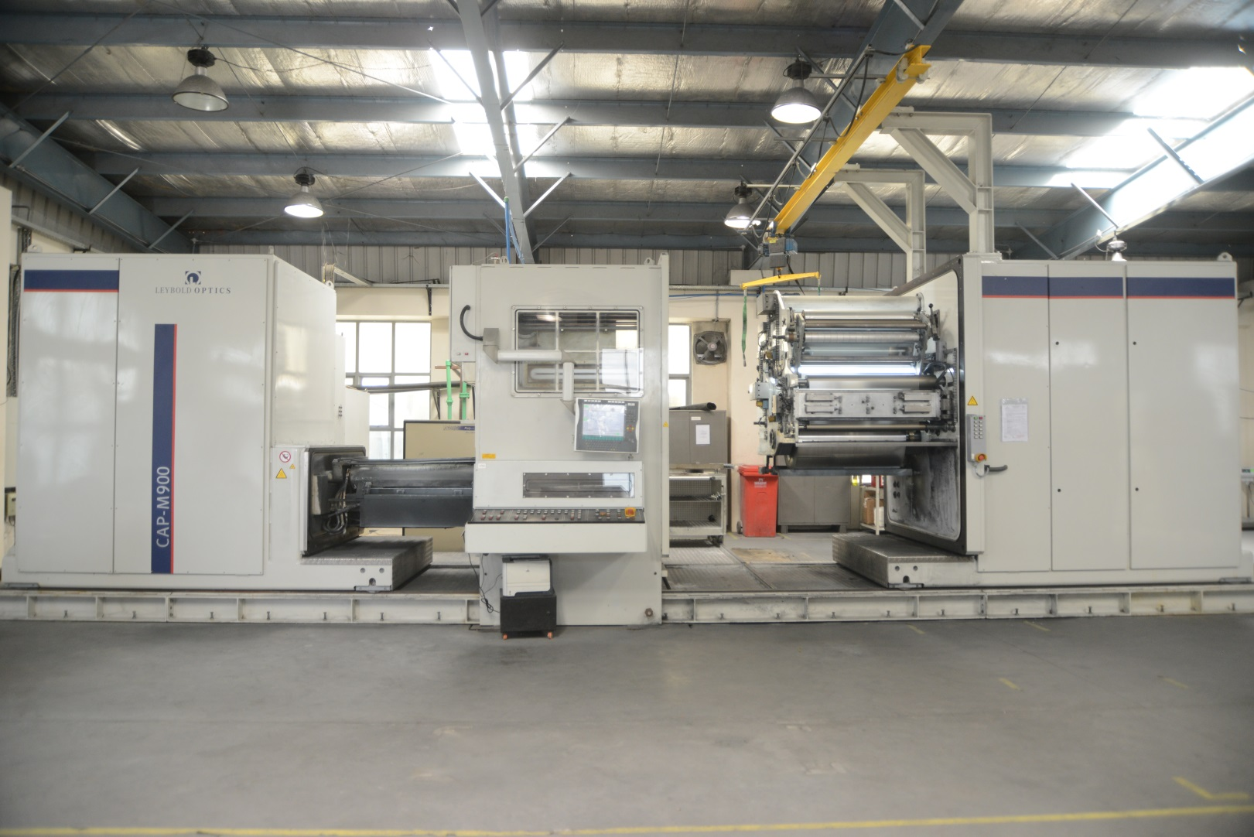
Infrastructure
Metallizing Machine – Leybold, Germany

Slide 7
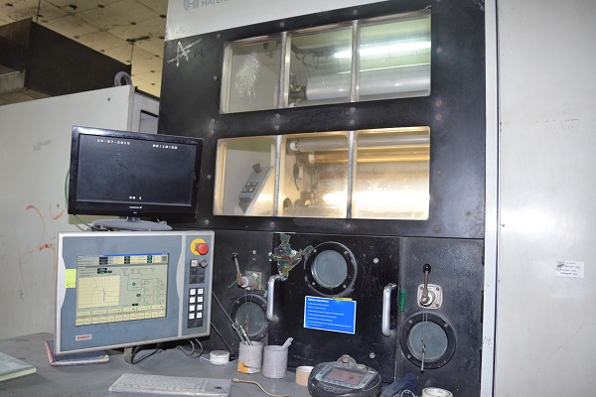
Infrastructure
Metallizing Machine

Slide 8
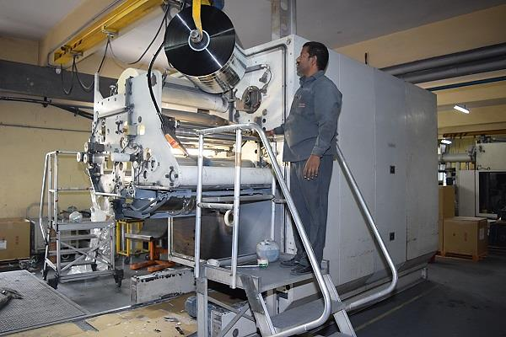
Infrastructure
PP Film Metallizing Machine

Slide 9
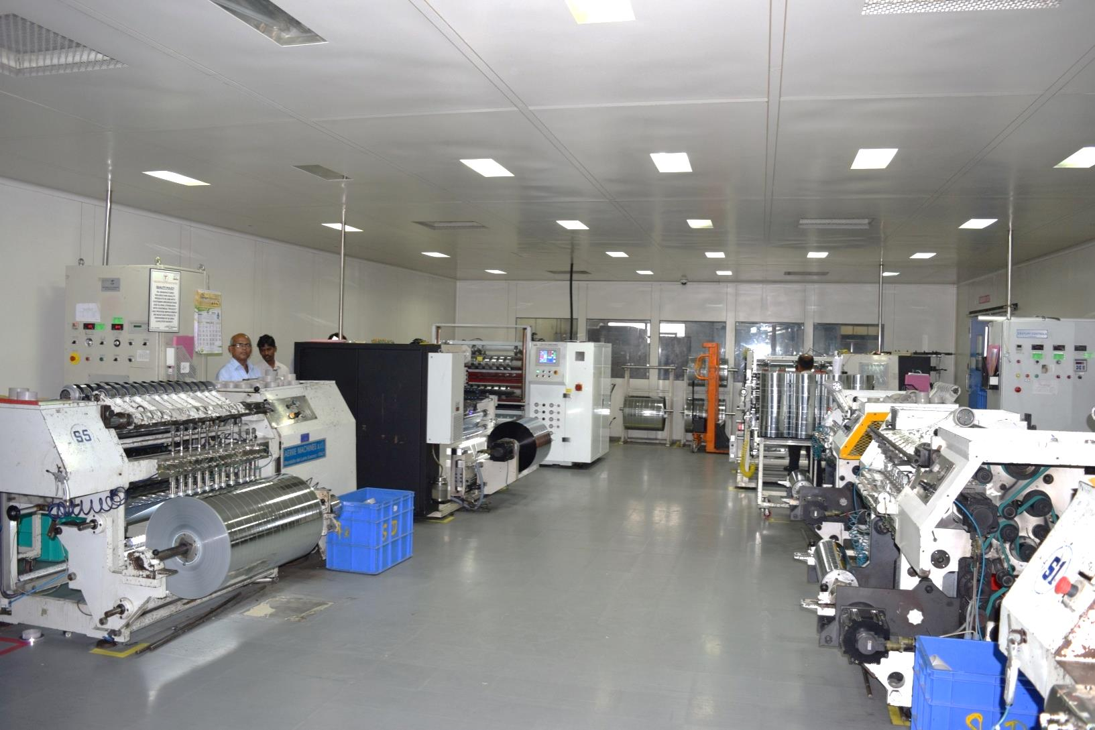
Infrastructure
Class 10,000 Dust Free Slitting Room

Slide 10
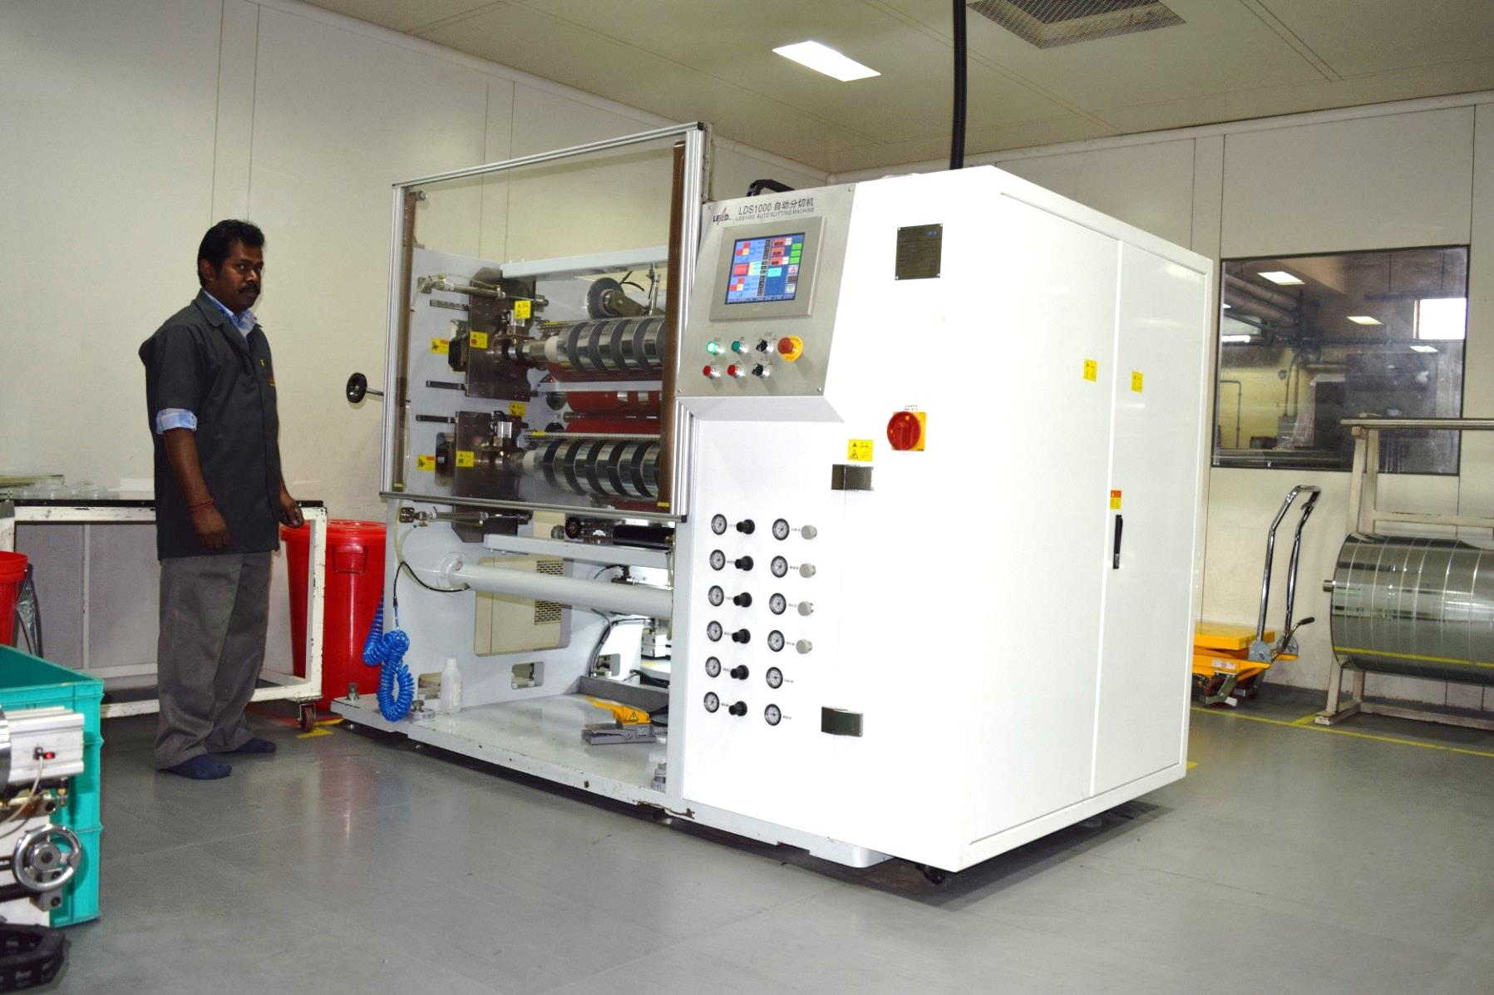
Infrastructure
Slitting Machine

Slide 11
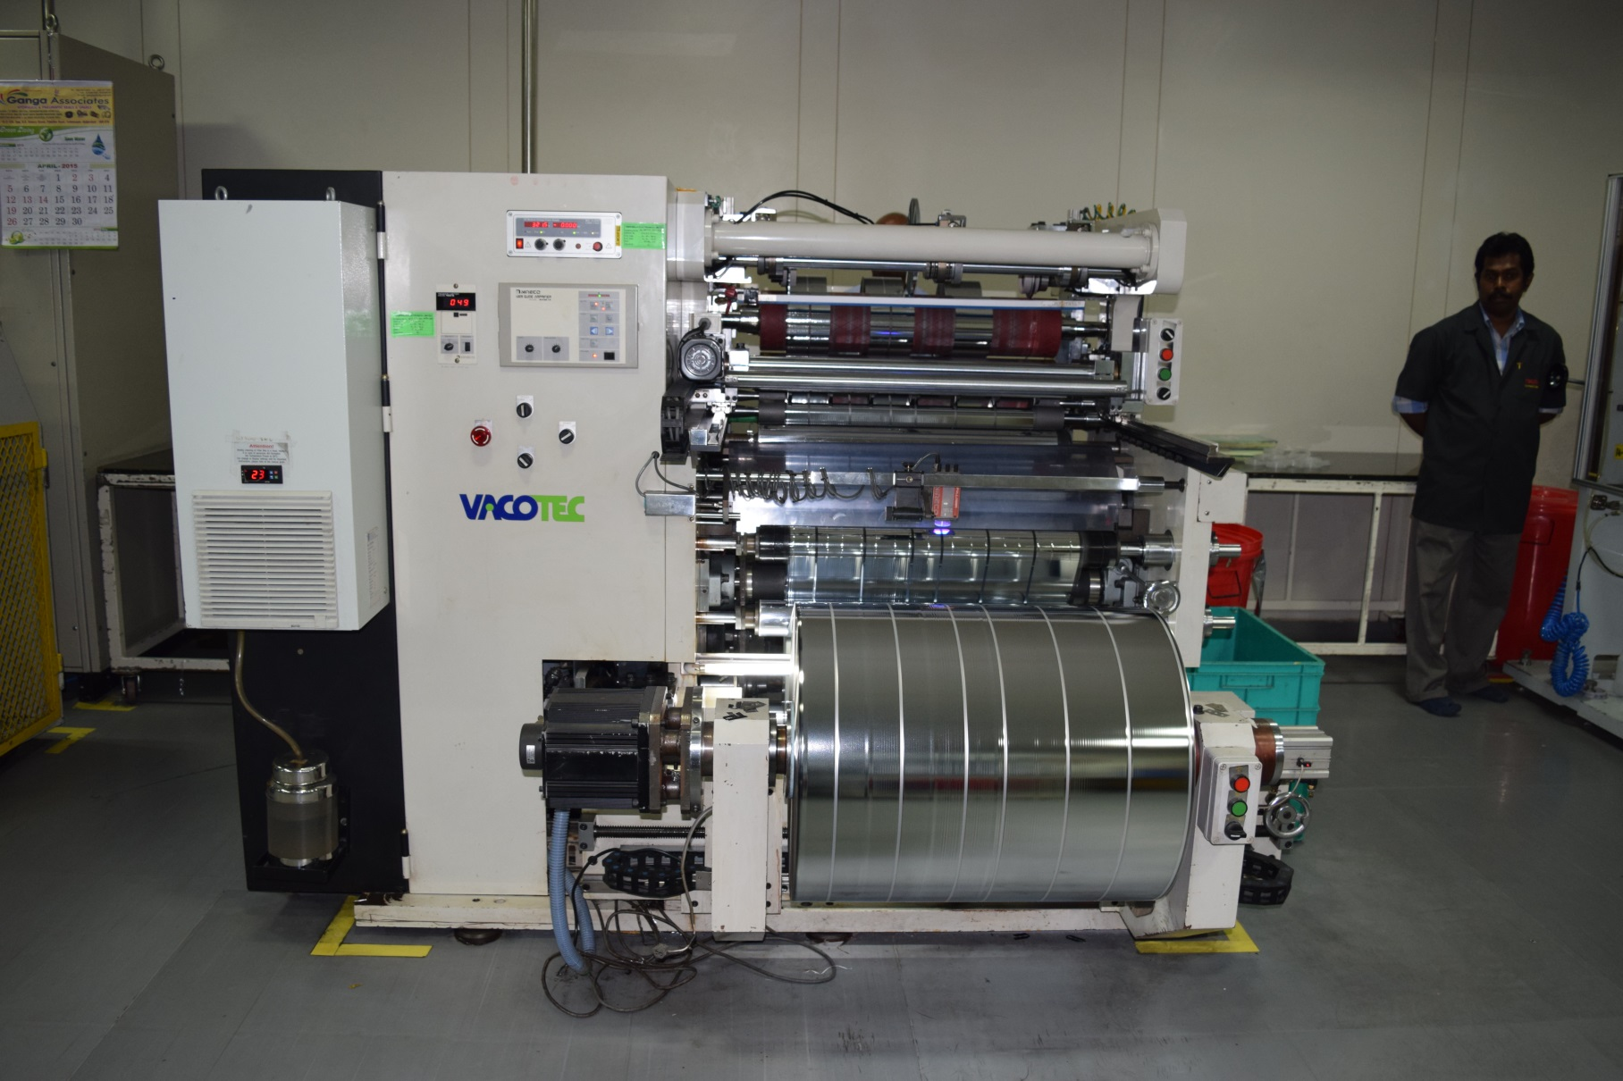
Infrastructure
World class MPP Film Slitting Machine

Slide 12
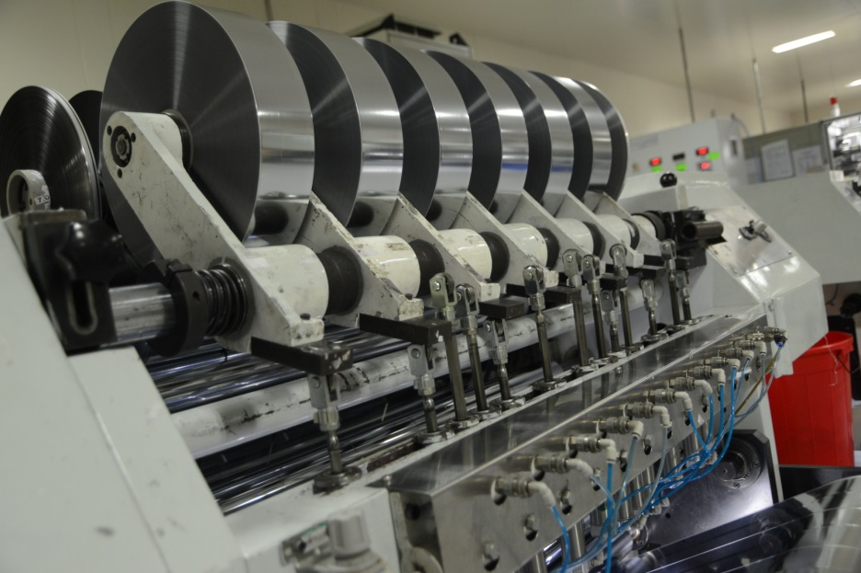
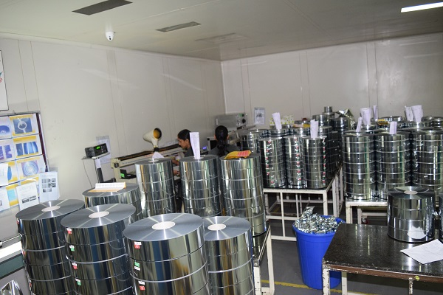
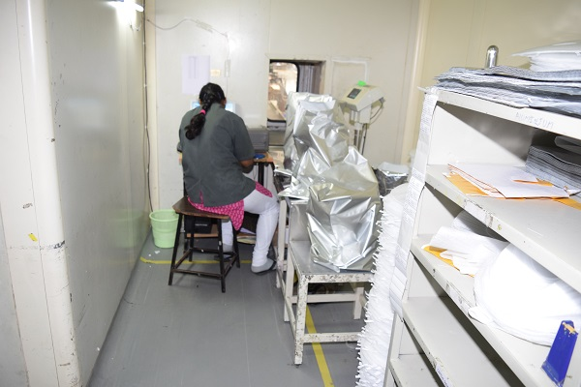
Infrastructure
MPP Film Testing & Packing

Slide 13
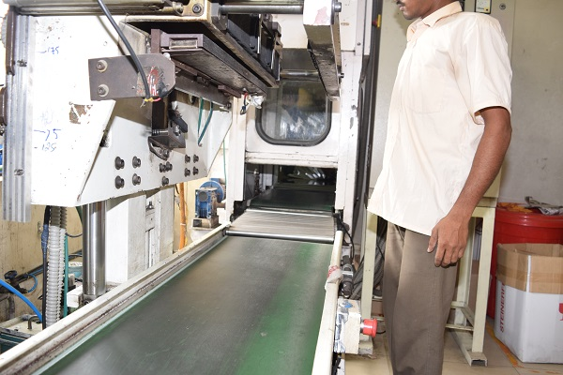
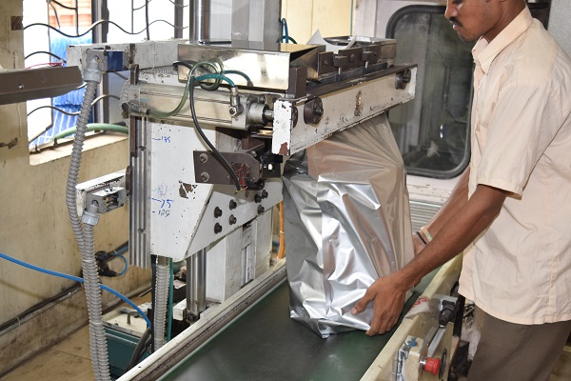
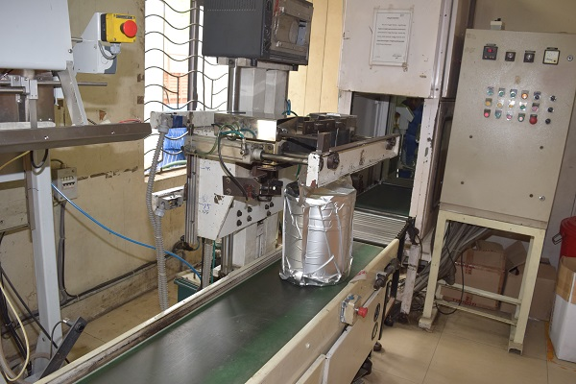
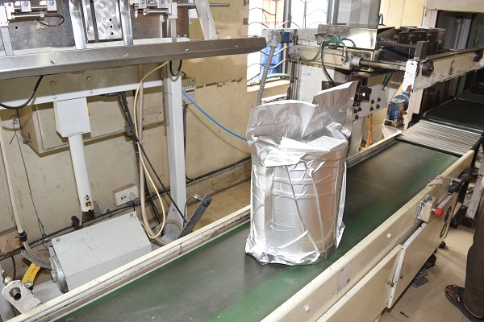
Infrastructure
Automated MPP Film Packing

Slide 14
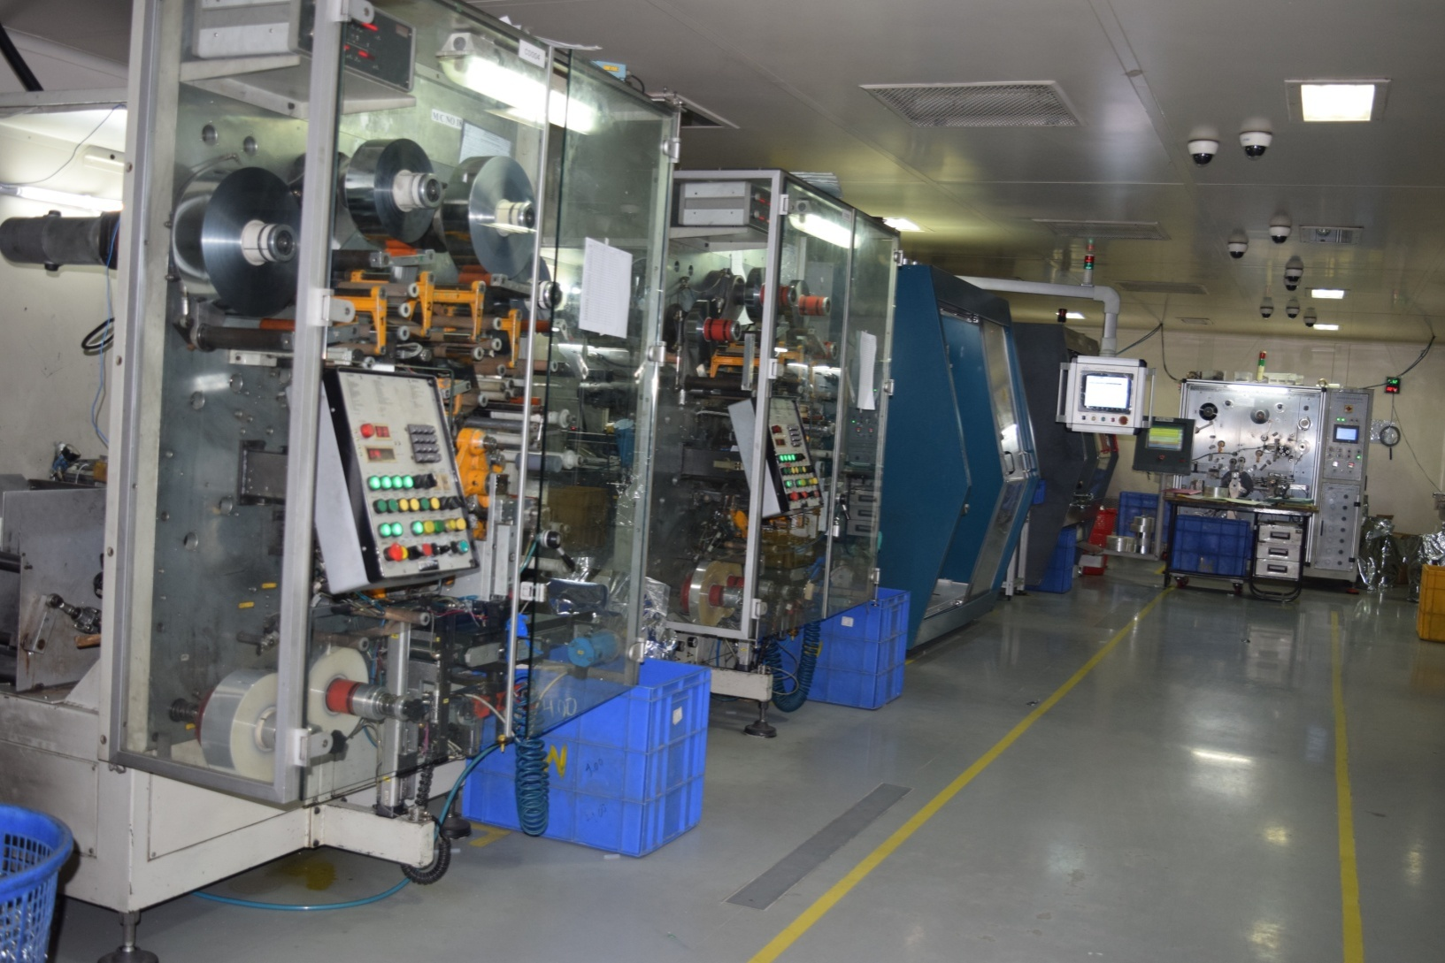
Infrastructure
Class 10,000 dust Free Winding Room

Slide 15
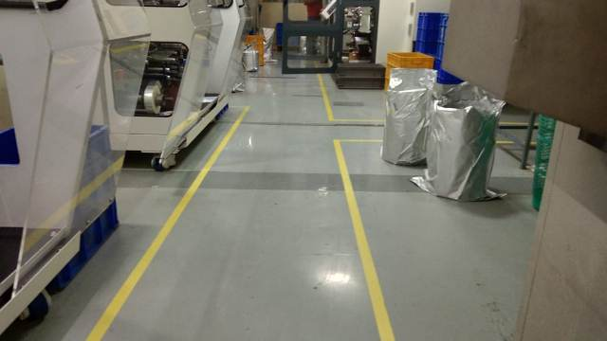
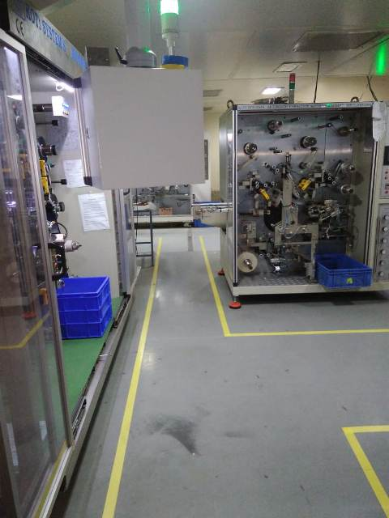
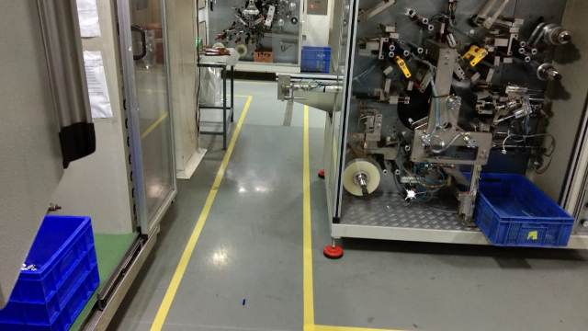
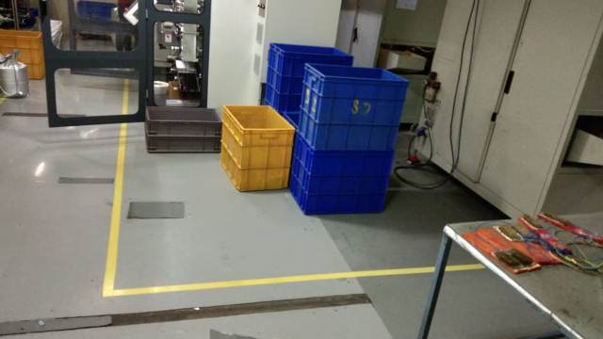
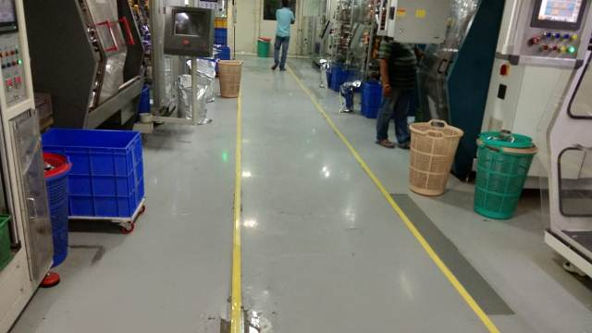
Infrastructure
Automatic Winding

Slide 16
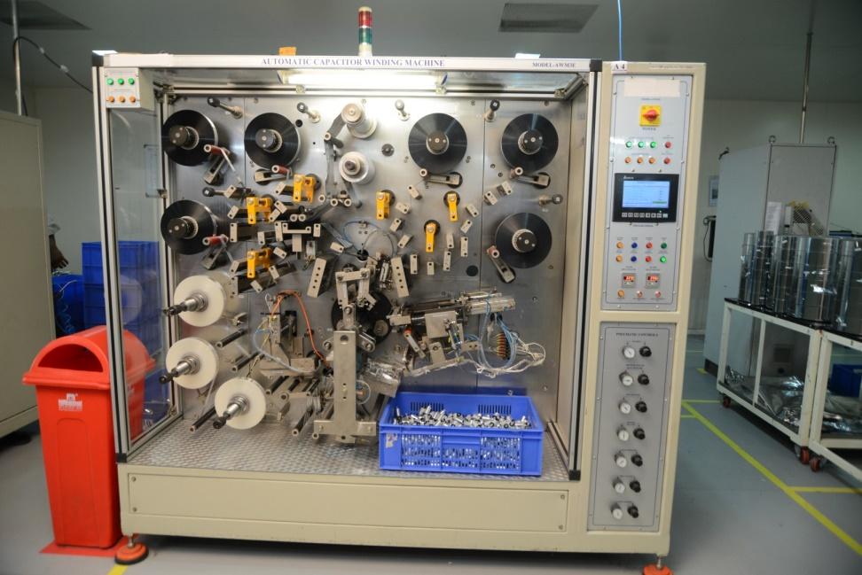
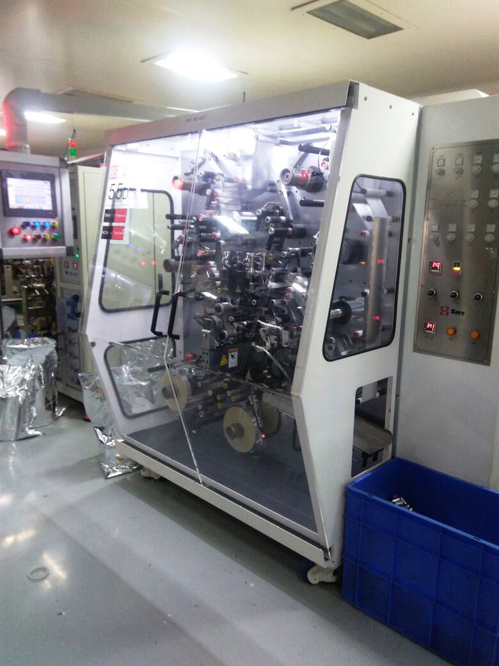
Infrastructure
World class Fully Automated
High Speed Winding Machines…..

Slide 17
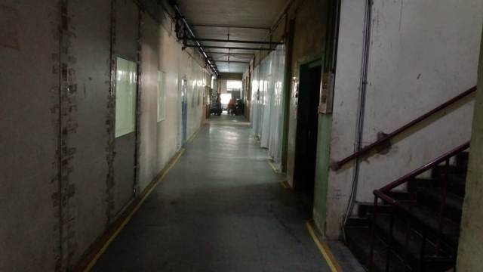
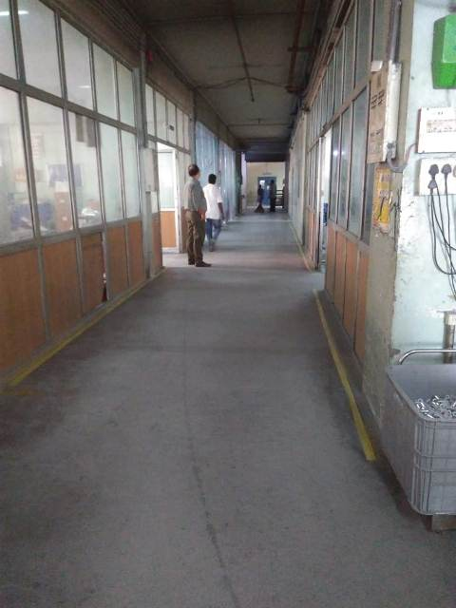
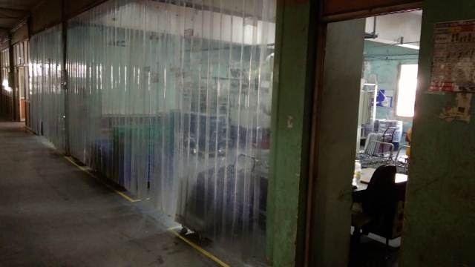
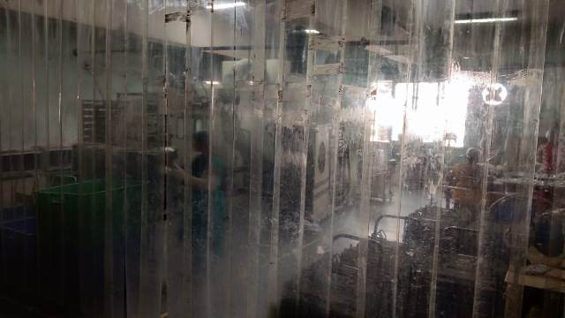
Infrastructure
Metal Spray Section

Slide 18
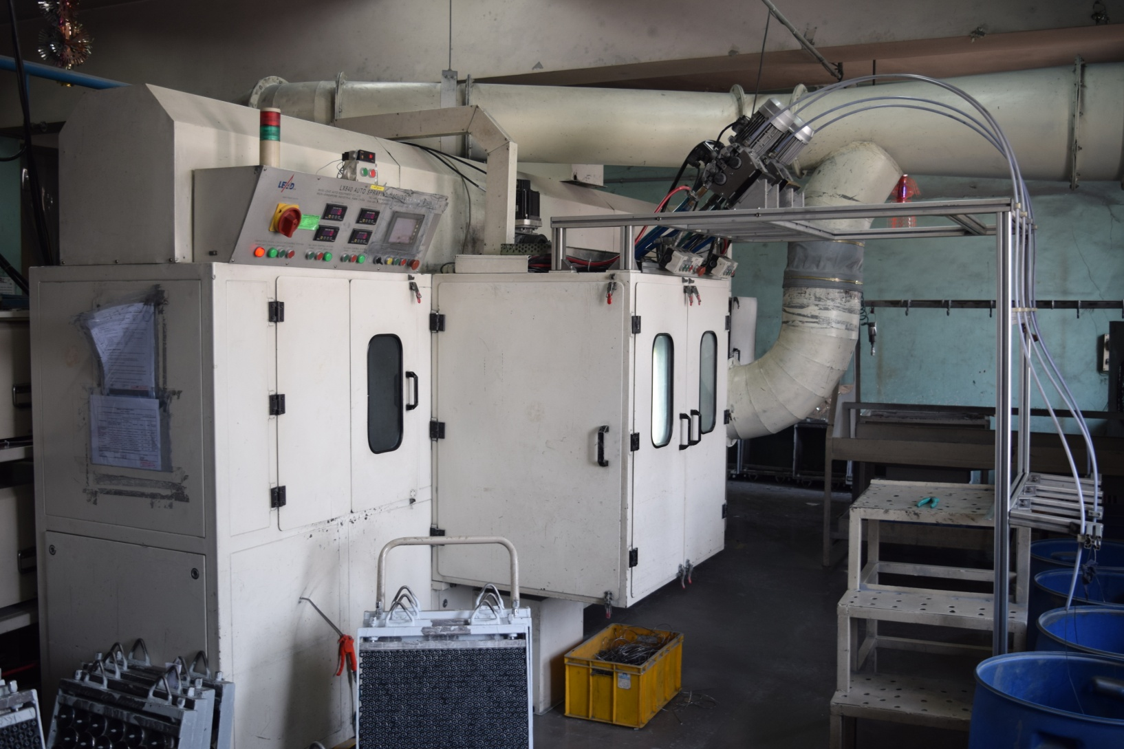
Infrastructure
Fully Automatic Zinc Metal Spray

Slide 19
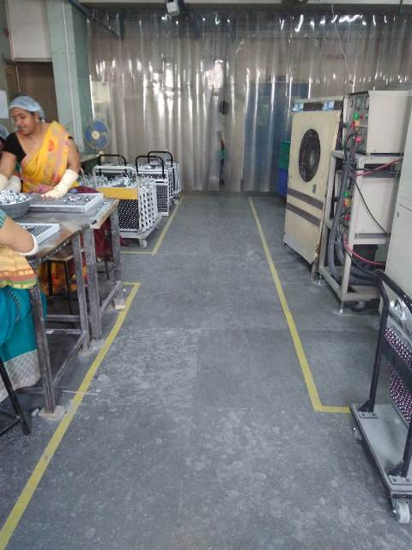
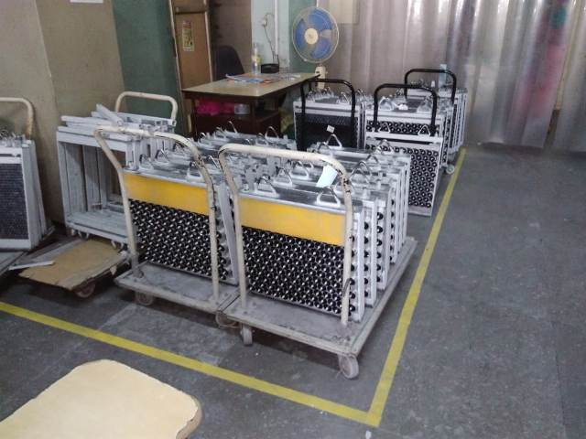
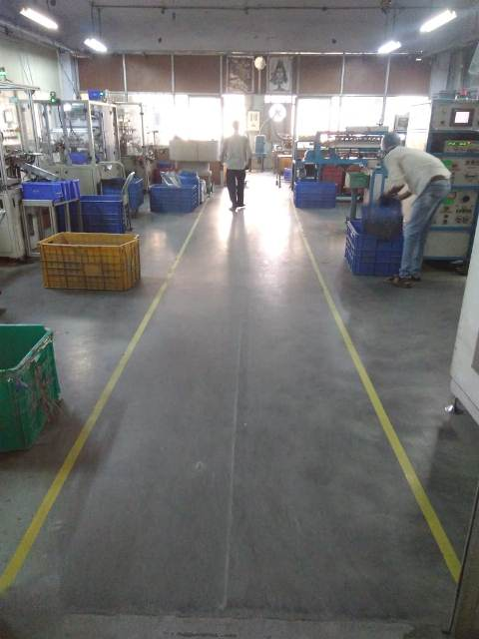
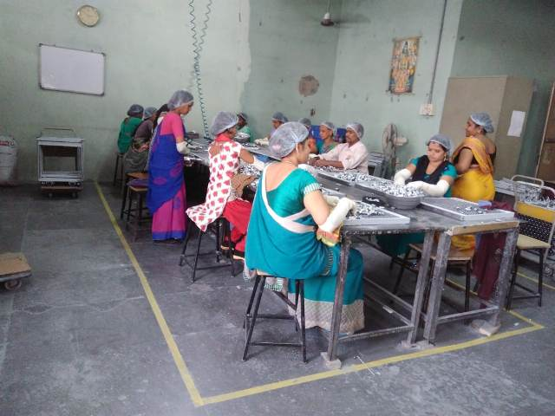
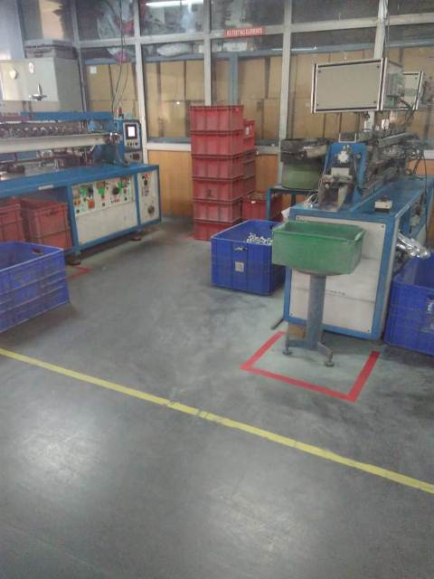
Infrastructure
Metal Spray Area

Slide 20
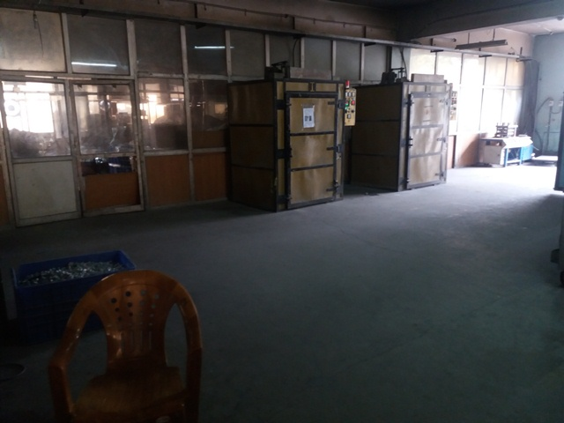
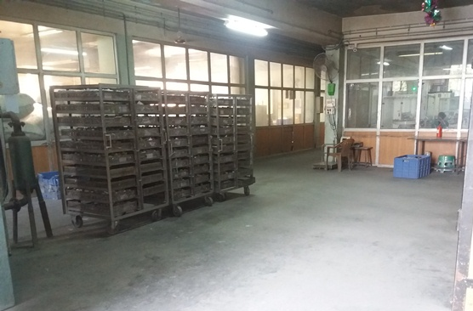
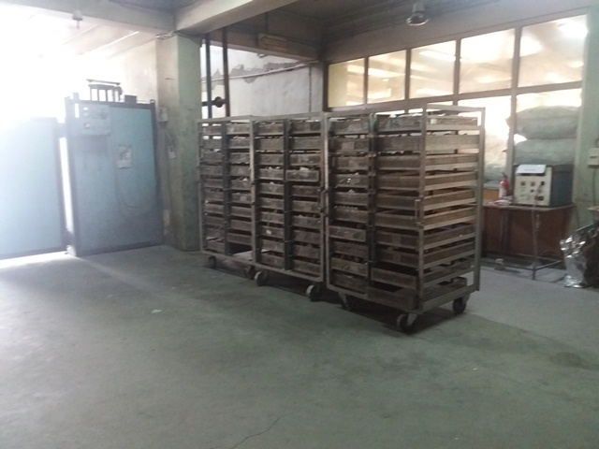
Infrastructure
Heat Stabilization

Slide 21
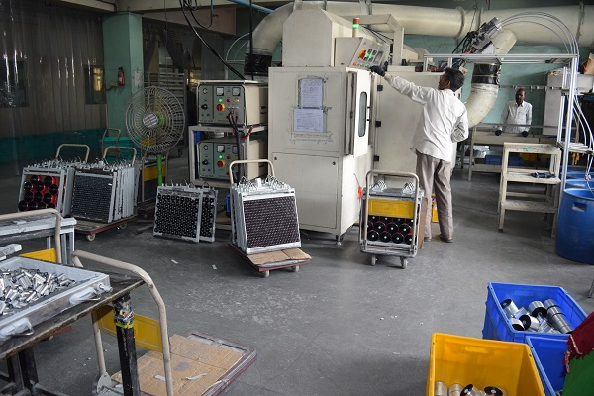
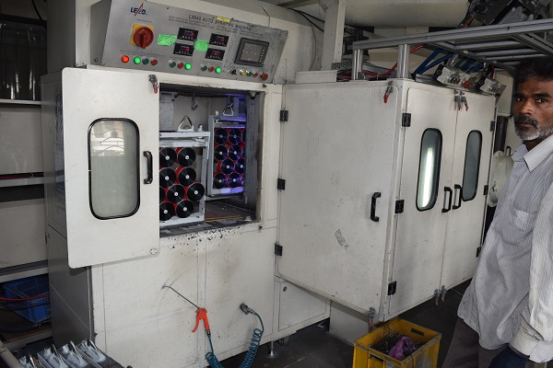
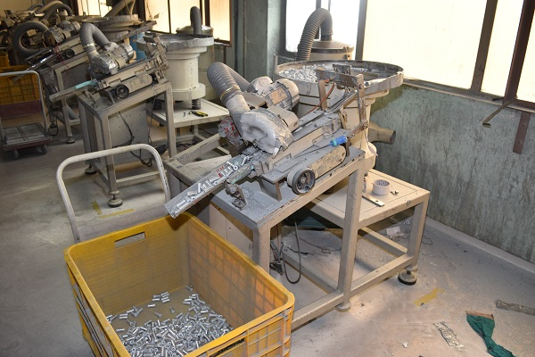
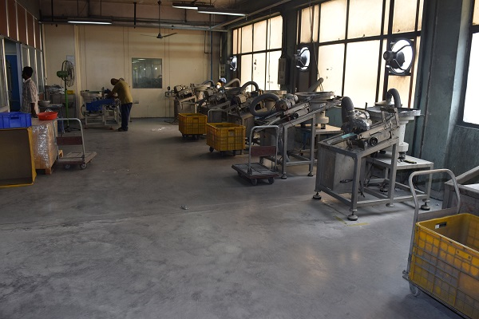
Infrastructure
Spray & Cleaning

Slide 22
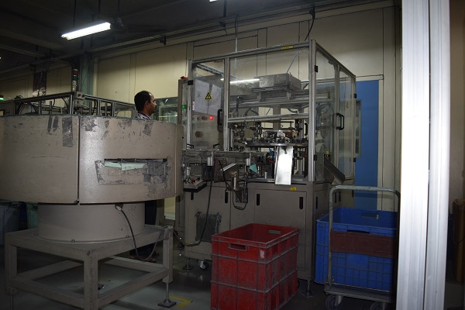
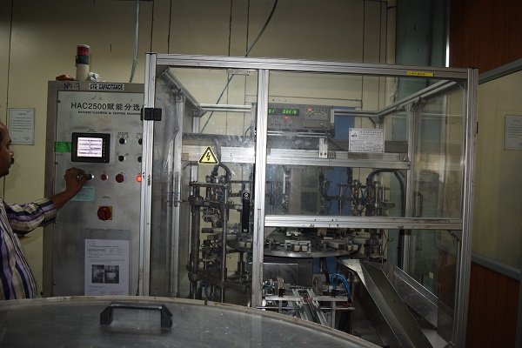
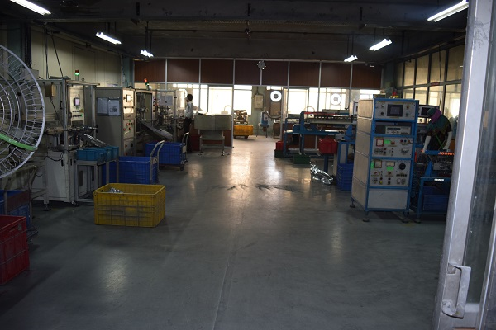
Infrastructure
Automatic Elect.Testing

Slide 23
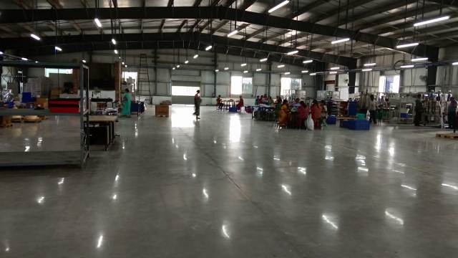
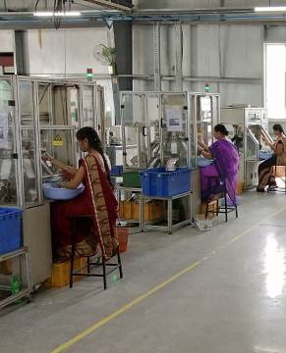
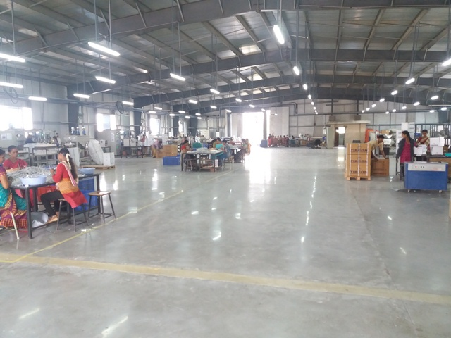
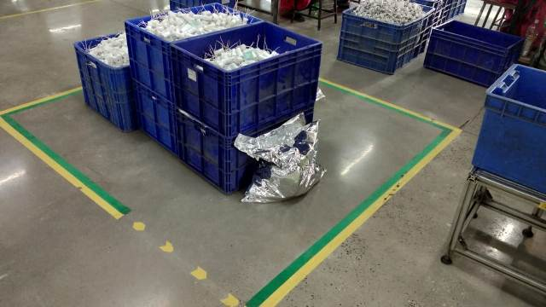
Infrastructure
Typical Assembly Area

Slide 24
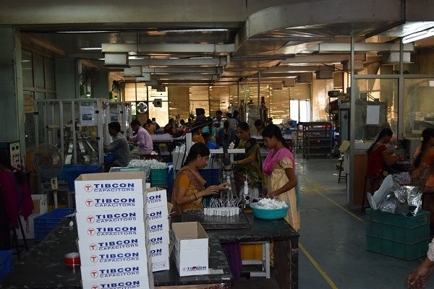

Infrastructure
Typical Assembly Area

Slide 25

Infrastructure
Fully Automated Fan / Motor Run Capacitors Assembly Lines
C:\Users\MAHENDRA\Desktop

Slide 26



Infrastructure
BIS/ IEC Standard Life test set up

Slide 27





Quality Certifications
Our products confirm to global industry norms & International standards such as :
    ISO 9001-2015
    RoHS / REACH Compliant
    UL 810 ( Underwriters Laboratories)
    CSA ( Canadian Standards)
    CE (European-Declaration of Conformity )
    ISI ( Indian Standards Institution)

Slide 28


Product Range
AC CAPACITORS – Used in Fans, Air Conditioners, Refrigerators, Air Coolers, Motors, Lighting etc.,
PFC CAPACITORS – Used in Industries, Agricultural Pump Sets and Windmill for Power Factor Maintenance
METALLIZED POLYPROPYLENE FILM – Major input in the manufacture of capacitors. The Company consumes MPP Film for captive purpose as well as sells to other Capacitor manufacturers

Slide 29
Features
Made with MPP Film imported from Germany that can Withstand Higher Voltages without Breakdown
Special Wave Slitting that allows the Capacitor to withstand Higher Inrush Currents
Non-PCB Oil Encapsulation
High Temperature Withstanding Capacity
Self Healing Properties
Tested at CPRI, Bangalore with outstanding results
Available in both PP Can & Explosion Proof Metal Top Design
Manufacturing more than 250000 capacitors per day in more than 3000 verities as per the requirement of all type of customers.

Slide 30
PFC Capacitors - Range
TYPE | VOLTAGE | TYPE | OUTPUT
STANDARD DUTY | 400V | CYLINDRICAL | 1 - 50KVAR
 |  | BOX TYPE | 1 - 25KVAR
 | 440V | CYLINDRICAL | 1 - 50KVAR
 |  | BOX TYPE | 1 - 25KVAR
HEAVY DUTY | 440V | CYLINDRICAL | 5 - 25KVAR
 |  | BOX TYPE | 5 - 25KVAR
 | 480V | CYLINDRICAL | 5 - 25KVAR
 |  | BOX TYPE | 5 - 25KVAR
SUPER HEAVY DUTY | 525V | CYLINDRICAL | 5 - 25KVAR
 |  | BOX TYPE | 5 - 25KVAR
 | 690V | CYLINDRICAL | 5 - 25KVAR
 |  | BOX TYPE | 5 - 25KVAR

Slide 31

PFC Capacitors - Construction
Standard Duty capacitors are manufactured by using standard thickness of dielectric material with heavy edge metallization along with special slope and wave cut profile.
Heavy duty Capacitors are manufactured with thicker dielectric material with heavy edge metallization along with special slope profile and wave cut profile, housed in a bigger aluminum can.
Super Heavy Duty capacitors are made of internal series metallized film, which reduces the terminal voltage at the capacitor level by half. This results into drastic reduction of temperature with in the capacitor.

Slide 32
Range
Fan Capacitors – Dry in PP Can & Oil Capacitor in Aluminium Can
Motor run Capacitors – PP, Aluminum & Box Type
Motor Start Capacitors
Lighting Capacitors
Submersible Pump Capacitors
Air Conditioning & Refrigeration Capacitors
Dual Capacitors
PFC Capacitors – Cylindrical & Box Type from 230V-690V.Mainly for Industrial, Agricultural and Windmill applications..

Slide 33
Important Customers
Fan Capacitors – Crompton, Orient, Havells, Bajaj, Ancho, Panasonic, V-Gurad, Ajanta Orpat,Polar and GM etc
Motor run Capacitors – Crompton, Kirloskar, Shakthi Pumps, Sharp,CRI Pumps etc.
Air Conditioning – Voltas, Blue star, Tecumseh, Videocon etc.
Lighting Capacitors – Philips (India & USA), CG, Bajaj etc.
We export 7-8 containers of Capacitors & Film to various countries across the globe.
Globally we supply Lighting Capacitors to Philips
Our Air Conditioning capacitors we supply in good quantity to UAE & Qatar markets
Our Power Capacitors we export to Eastern European, Middle East & Asian countries in TIBCON brand.

Slide 34
TEL - Strengths
TEL has been procuring, running and maintaining automatic and sophisticated machinery imported from Europe, Korea and China to manufacture highly reliable capacitors.
The Company has good production ancillary units forming business associates in providing various components and sub components.
The Company upgrades the products on a continuous basis and a variety of 300+ Capacitor models & production of 75Million capacitors per annum
The Company has got global approvals and Product Certifications - UL Certificate from Under Writer Laboratories Inc (USA), CSA-Certificate from Canadian Standards Association and other approvals like IEC, CE, RoHS /REACH BIS etc.,
The Company has got ISO 9001 -2015 Quality System Certification.

Slide 35
TEL - Strengths
The company has four manufacturing facilities with a head count of more than 600 people.
Entered into Manufacturing Contract for Dry HID Lighting Capacitors with a US based company
Not a single working hours has been lost in last 30 years due to any labor unrest.
Excellent financial track record with all vendors, suppliers & bankers.
Personal involvement of the promoters, headed by Mr.Jyoti Prakash Tibrewala as Chairman, Mr.Vineet Tibrewala as Managing Director & Mr.Vishal Tibrewala as Director – Marketing.

Slide 36
Thank You

